Slide 1

Exam AZ-300: Microsoft Azure Architect Technologies Crash Course
Tim Warner

Slide 2

Tim Warner
Based in Nashville, TN, US
MCT since 1997
MVP since 2017
Twitter: @TechTrainerTim
Work: Pluralsight.com
Web: TechTrainerTim.com

Slide 3
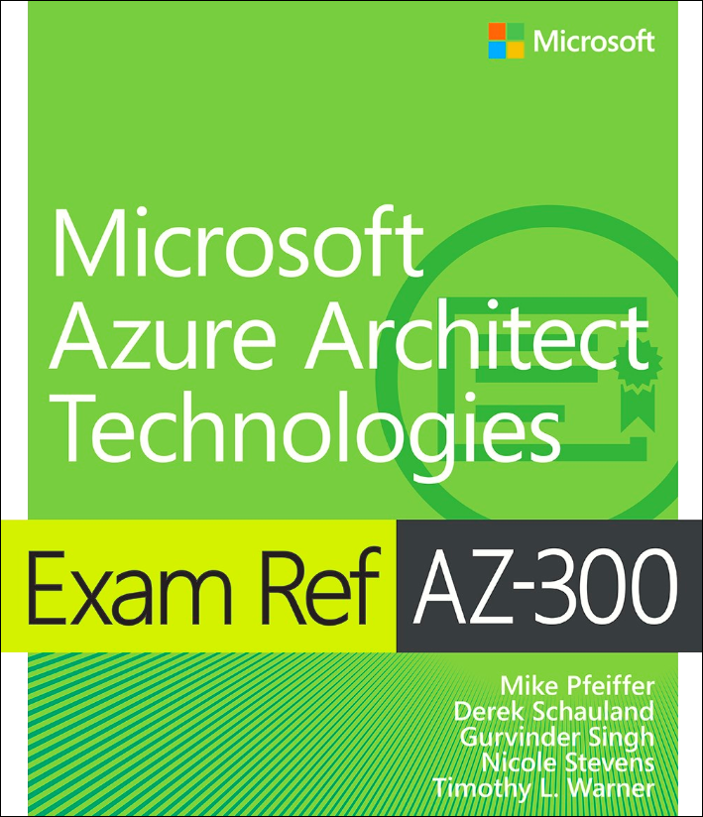
Tim Warner
Available for preorder
25-Nov-2019 pub date
timw.info/ms300
Safari Books Online

Slide 4
Course Materials
timw.info/az300

Slide 5
Day 1 of 2 Agenda
Introduction
Azure storage
Azure IaaS architecture
Virtual machines
Networking
Azure security and governance
Subscription management
RBAC
Migration to Azure

Slide 6
Day 2 of 2 Agenda
Azure App Service family
Containers in Azure
Authentication and data security
Event/message pipelines
AZ-300 certification strategy

Slide 7
Tim's Certification Study Pyramid
Interdependence
Content knowledge
Practical application
Test-taking skills

Slide 8

Let's get to work!

Slide 9
Module 1: Deploy and Configure Azure Infrastructure

Slide 10
Module 1 Learning Objectives
Analyze resource utilization and consumption
Create and configure storage accounts
Create, configure, and automate deployment of Windows and Linux virtual machines (VMs)
Create connectivity between virtual networks

Slide 11
Module 1 Learning Objectives (Cont’d)
Implement and manage virtual networking
Manage Azure Active Directory (Azure AD)
Implement and Manage Hybrid Identities

Slide 12
Our Environment

Slide 13
Module 2 Implement Azure Workloads and Security

Slide 14
Module 2 Learning Objectives
Migrate servers to Azure
Configure serverless computing
Implement application load balancing

Slide 15
Module 2 Learning Objectives (Cont’d)
Integrate an on-premises network with an Azure virtual network
Manage role-based access control (RBAC)
Implement Multi-Factor Authentication (MFA)

Slide 16
Module 3: Create and Deploy Apps in Azure

Slide 17
Module 3 Learning Objectives
Create web apps by using PaaS
Design and develop apps that run in containers

Slide 18
Module 4: Implement Authentication and Secure Data in Azure

Slide 19
Module 4 Learning Objectives
Implement authentication
Implement secure data solutions

Slide 20
Module 5: Develop for the Cloud and for Azure Storage

Slide 21
Module 5 Learning Objectives
Develop solutions that use Cosmos DB storage
Develop solutions that use a relational database
Configure a message-based integration architecture
Develop for autoscaling

Slide 22
Module 6: Exam AZ-300 Exam Strategy

Slide 23
Module 6 Learning Objectives
Grasp the content
Acquire the hands-on skills
Master computer-based testing
Comprehend what to expect before, during, and after the exam

Slide 24
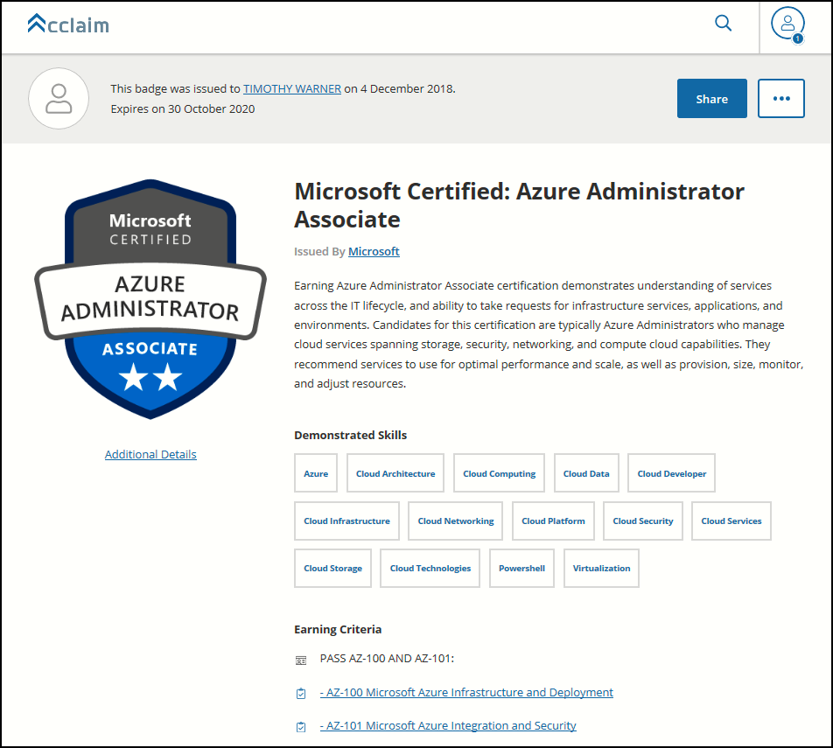
Digital Credentials by Credly/Acclaim

Slide 25

Multiple Choice

Slide 26
Repeated Scenario
You need to move an Azure VM to another hardware host.
Solution: You redeploy the VM.
Does this solution meet the goal?
Yes
No

Slide 27

Select and Place

Slide 28

Build List and Reorder

Slide 29

Active Screen/Fill in the Blank

Slide 30

Case Study

Slide 31

Performance-Based Lab

Slide 32
Thank you!
Course materials: timw.info/az300
Twitter: @TechTrainerTim
Work: Pluralsight.com
Web: TechTrainerTim.com

